Slide 1
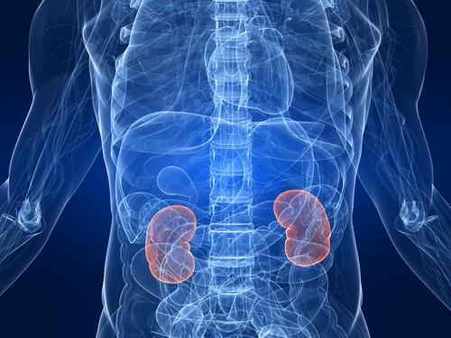
Renal and Urinary System
https://www.summitmedicalgroup.com

Slide 2
Note
Much of the text material is from, “Principles of Anatomy and Physiology” by Gerald J. Tortora and Bryan Derrickson (2009, 2011, and 2014). I don’t claim authorship. Other sources are noted when they are used.
The lecture slides are mapped to the three editions of the textbook based on the color-coded key below.
14th edition
13th edition
12th edition
Same figure or table reference in all three editions

Slide 3
Outline
Overview
Structure and functions
Glomerular filtration
Tubular reabsorption and secretion
Urine production
Evaluation of kidney function
Urine transport, storage, and elimination
Waste management in other body systems
Aging

Slide 4
Overview

Slide 5
Overview
The renal and urinary system includes the kidneys, ureters, urinary bladder, and urethra.
The kidneys perform the major work, while the other sections serve as passageways and storage areas for urine.
Renal = relating to the kidneys.
Page 979
Page 1065
Page 1018

Slide 6
Overview (continued)
The kidneys filter blood plasma and return much of the water and its solutes to blood circulation.
The remaining water and solutes form urine, which passes into the ureters and is stored in the bladder until it is eliminated from the body through the urethra.
Solute = a dissolved substance in a solution.
Page 979
Page 1065
Page 1018

Slide 7
Definitions
Nephrology is the study of the structure, function, and pathology of the kidneys.
Urology is the branch of medicine for the urinary system and male reproductive system.
Page 979
Page 1065
Page 1018

Slide 8
Structure and Functions

Slide 9
Renal (Kidney) Functions
Formation of urine by filtration of blood plasma
Excretion of metabolic wastes (such as ammonia, urea, and uric acid)
Regulation of ionic composition (such as Na⁺, K⁺, Ca²⁺, Cl⁻, and HPO4²⁻)
Reabsorption of water and some ions
Secretion of foreign substances (such as drugs)
Regulation of blood pH (excrete H⁺ and conserve the buffer HCO3⁻)
Page 981
Page 1067
Page 1020

Slide 10
Renal (Kidney) Functions (continued)
Regulation of blood volume (conserving or eliminating water)
Regulation of blood pressure (secretion of the enzyme renin)
Synthesis of the hormone, erythropoiten for red blood cell production
Synthesis of the hormone calcitriol, the active form of vitamin D
Gluconeogenesis (synthesis of glucose from the amino acid, glutamine)
Page 981
Page 1067
Page 1020

Slide 11
General Description
The kidneys, which are located slightly above waistline, are shaped like kidney beans.
A kidney is about the size of a bar of bath soap, measuring about 10 to 12 cm long, 5 to 7 cm wide, and 3 cm thick.
The right kidney is positioned lower than the left kidney because the liver occupies the space superior to it.
The kidneys are retroperitoneal since they are outside and posterior to the peritoneum of the abdominal cavity.
Peritoneum = the serous membrane lining the cavity of the abdomen and covering the abdominal organs.
Page 981
Page 1067
Page 1020
Figure 26.1

Slide 12
Internal Structure
A cross-section through the kidney reveals two distinct regions of tissues:
An outer, light red area known as the renal cortex.
A deeper, darker reddish-brown inner region called the renal medulla.
The renal medulla consists of several cone-shaped structures called renal pyramids.
Page 983
Page 1069
Page 1022
Figure 26.3

Slide 13
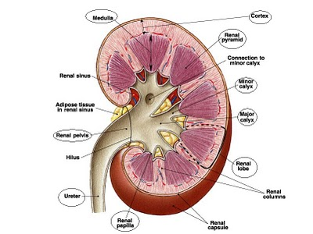
Kidney
https://www.sites.google.com/site/bio379swhittemore

Slide 14
Renal Columns and Renal Lobes
The renal cortex that extends between two renal pyramids is called a renal column.
A renal lobe consists of a renal pyramid, the overlying area of renal cortex, and one-half of each adjacent renal column.
Page 984
Page 1069
Page 1022
Figure 26.3

Slide 15
Parenchyma and Nephrons
The renal cortex and renal pyramids form what is called the paren-chyma.
About one million nephrons are located in the parenchyma of each kidney.
The nephrons are the functional units of the kidneys where blood is filtered.
Nephrons also reabsorb ions and water and secrete other ions and some substances in the formation of urine—to be discussed later in the lecture module.
Parenchyma = the essential or functional elements of an organ.
Page 984
Page 1069
Page 1022
Figure 26.3

Slide 16
Renal Corpuscle
Each nephron has two components:
Renal corpuscle where blood plasma is filtered and collected
Renal tubule into which the filtered fluid (filtrate) passes
The renal corpuscle has a tangled, ball-shaped capillary network called the glomerulus.
Blood is filtered in the glomerulus—filtered fluid (filtrate) passes through the capillary walls known as the filtration membrane.
Blood plasma = watery fluid, about 55 percent of blood volume, minus the formed elements (red blood cells, white blood cells, and platelets).
Page 984
Page 1071
Page 1024
Figure 26.6

Slide 17
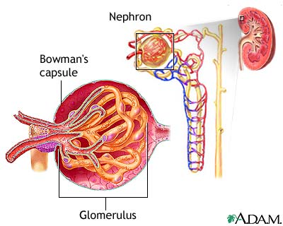
Renal Corpuscle (continued)
Kidney
Nephron (enlarged)
Renal corpuscle
(further enlarged)
https://www.pitt.edu
Renal corpuscle = Bowman’s capsule and glomerulus.

Slide 18
Renal Corpuscle (continued)
Bowman’s capsule is a double-walled cup of cuboidal epithelial cells that surrounds the glomerulus.
Filtrate from the glomerulus passes into Bowman’s capsule and then into the renal tubule.
Bowman’s capsule is also known as glomerular capsule (we will use the first term).
Cuboidal = cube-shaped.
Page 984
Page 1071
Page 1024
Figure 26.6

Slide 19
Renal Tubule
The three sections of the renal tubule are the:
Proximal convoluted tubule (closest to the renal corpuscle)
Loop of Henle
Distal convoluted tubule (farthest from the renal corpuscle)
The proximal and distal convoluted tubules are located in the renal cortex.
Convoluted = coiled or curved rather than straight.
Page 984
Page 1071
Page 1024
Figure 26.5

Slide 20
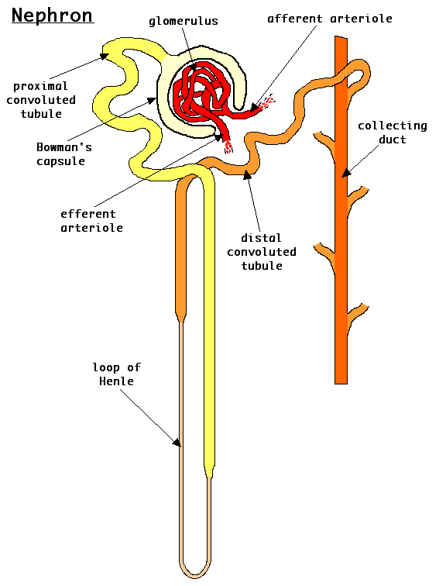
Renal Tubule (continued)
1. Proximal convoluted tubule
3. Distal convoluted tubule
2. Loop of Henle
https://www.auburn.edu

Slide 21
Renal Tubule (continued)
The loop of Henle extends into the renal medulla, where it makes a tight turn to return to the renal cortex.
Each of the three sections of the renal tubule has specific functions in the formation of urine, as will be discuss when we cover tubular reab-sorption and tubular secretion.
Page 984
Page 1071
Page 1024
Figure 26.5

Slide 22
Collecting Duct
The distal convoluted tubules of several nephrons empty into a single collecting duct.
Collecting ducts converge into several hundred large papillary ducts.
Papillary ducts converge to form the minor and major calyces, which drain into the renal pelvis.
Urine drains from each renal pelvis into the ureters for storage in the bladder.
Page 990
Page 1072
Page 1025
Figure 26.5

Slide 23
Collecting Duct (continued)
Collecting duct
Multiple nephrons share a collecting duct.
https://www.auburn.edu
23
Notes:
23

Slide 24
Cortical Nephron
About 80 to 85 percent of the nephrons are cortical—their renal cor-puscles are in the outer region of the renal cortex.
They have short loops of Henle that barely penetrate the outer region of the renal medulla.
Cortical nephrons perform much of the filtration process in the kidneys due to their large numbers.
Page 986
Page 1073
Page 1025
Figure 26.5

Slide 25
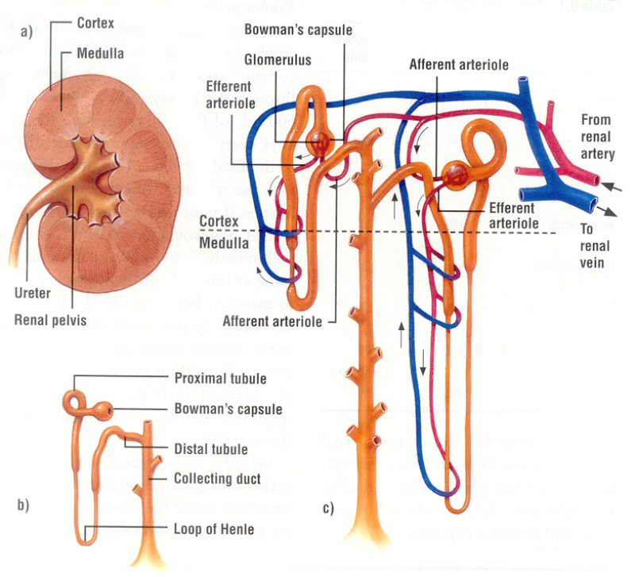
Cortical Nephron (continued)
Cortical nephron (to the left)
Juxtamedullary nephron (right)
https://wwwkvhs.nbed.nb.ca
25
Notes:
25

Slide 26
Juxtamedullary Nephron
The other 15 to 20 percent of nephrons are juxtamedullary— their renal corpuscles are deep within the cortex.
They have long loops of Henle that extend into the deepest regions of the renal medulla.
The long loops of Henle enable the excretion of very diluted or very concentrated urine.
Juxta- = in close proximity.
Page 986
Page 1073
Page 1025
Figure 26.5

Slide 27
Juxtamedullary Nephron (continued)
Cortical nephron (to the left)
Juxtamedullary nephron (right)
https://wwwkvhs.nbed.nb.ca

Slide 28
More on Nephrons
New nephrons are not formed after birth.
Increased kidney size as we grow to adulthood is due to hypertrophy (growth) of individual nephrons.
Replacements do not develop if nephrons are damaged or diseased.
Page 991
Page 1076
Page 1025

Slide 29
More on Nephrons (continued)
Renal disease usually does not become apparent until kidney func-tion declines to less than 25 percent of normal.
The remaining nephrons can adjust to handle a higher-than-normal filtration load.
Surgical removal of a kidney will stimulate hypertrophy of the other kidney.
The remaining healthy kidney will adjust and eventually filter about 80 percent of the blood that had previously been filtered by both kid-neys.
Page 991
Page 1076
Page 1025

Slide 30
Renal Blood Supply
The kidneys must receive abundant blood supply since they remove waste from the blood and regulate its volume and ionic composition.
Although the kidneys receive 20 to 25 percent of the resting cardiac output, they represent less than 0.5 percent of the total mass of the body.
Blood flow to both kidneys is about 1,200 mL (1.2 L) per minute in an adult at rest.
Blood is supplied to the kidneys via the right and left renal arteries.
Page 984
Page 1069
Page 1022
Figure 26.4

Slide 31
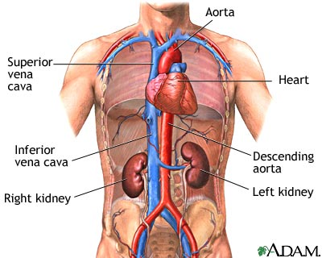
Renal Blood Supply (continued)
https://www.nlm.nih.gov

Slide 32
Arterial Blood
Each renal artery divides into several segmental arteries that supply different segments, or areas, of the kidney.
Each segmental artery branches into several interlobar arteries that enter the parenchyma and pass through the renal columns between the renal pyramids.
Interlobar arteries form arcuate arteries as they turn sharply at the base of each pyramid.
The arcuate arteries branch to form a series of interlobular arteries, which enter the renal cortex and branch to form afferent arterioles.
Red = arterial blood.
Page 984
Page 1069
Page 1022
Figure 26.4

Slide 33
Glomerulus
A nephron is supplied by an afferent arteriole that divides into the tangled, ball-shaped network of capillaries called the glomerulus.
The glomerular capillaries then rejoin to form an efferent arteriole.
The glomeruli are unique among capillary beds because they are positioned between arterioles (instead of between an arteriole and a venule in most tissues).
Glomeruli = plural form of glomerulus.
Page 984
Page 1069
Page 1022
Figure 26.4

Slide 34
Afferent and Efferent Arterioles
Afferent arteriole
Glomerulus
Efferent arteriole

Slide 35
Vasa Recta
The efferent arterioles branch to form the peritubular capillaries that surround the tubular portions of the nephrons in the renal cortex.
Long, loop-shaped capillaries known as the vasa recta extend from the efferent arterioles.
They supply the tubular portions of the nephrons in the renal medulla.
Purple = mixed (arterial and venous) blood.
Page 984
Page 1069
Page 1022
Figure 26.4

Slide 36
Venous Blood
The peritubular capillaries join to form the peritubular veins and then the interlobular veins.
The interlobuar veins also receive blood from the vasa recta.
Return blood flows through the arcuate veins into the interlobar veins between the renal pyramids.
Blood leaves each kidney through a renal vein that carries it into the inferior vena cava.
Blue = venous blood.
Page 984
Page 1069
Page 1022
Figure 26.4

Slide 37
Blood Supply—Summary
Renal artery
Segmental arteries
Interlobar arteries
Arcuate arteries
Interlobular arteries
Afferent arterioles*
Glomerular capillaries*
Efferent arterioles*
Peritubular capillaries*
Peritubular venules
Interlobular veins
Arcuate veins
Interlobar veins
Renal vein
Red—arterial blood
Purple—mixed
Blue—venous blood
* What will need to cover.
Page 984
Page 1069
Page 1022
Figure 26.4

Slide 38
Nerve Supply
Many of the renal nerves originate in the renal ganglion, a collection of nuclei (cell bodies of neurons) outside of the central nervous system.
The nerve fibers enter the renal plexus and the kidneys along with the renal arteries.
The renal nerves are part of the sympathetic division of the autonomic nervous system.
Most are vasomotor (they control the smooth muscles in arterial walls) to regulate blood flow through the afferent and efferent renal arterioles.
Plexus = a structure in the form of a network.
Vasomotor = pertaining to neural control of the constriction and dilation of blood vessels.
Page 984
Page 1069
Page 1022

Slide 39
Renal Functions
The nephrons perform three functions during the production of urine:
Glomerular filtration
Tubular reabsorption
Tubular secretion
The functions will be covered in the next sections of this lecture module.
Page 991
Page 1076
Page 1029
Figure 26.7

Slide 40
Glomerular Filtration

Slide 41
Glomerular Filtration
In glomerular filtration, water and the solutes in blood plasma pass:
Across the leaky walls of the glomerular capillaries,
Into Bowman’s capsule, and
Then into the renal tubule.
Page 992
Page 1077
Page 1030
Figure 26.7

Slide 42
Glomerular Filtration (continued)
The percentage of blood plasma in afferent arterioles that filters into Bowman’s capsules is called the filtration fraction.
The fraction normally ranges between 16 and 20 percent, although it can vary considerably in health and disease.
Page 992
Page 1077
Page 1030

Slide 43
Glomerular Filtration (continued)
The average daily volume of glomerular filtrate is 150 liters in adult females and 180 L in adult males.
More than 99 percent of the glomerular filtrate, however, returns to the blood via the process of tubular reabsorption—about 1.0 to 2.0 L are excreted as urine.
Glomerular filtrate = the water and solutes in blood plasma that pass from the glomerular capillary and into Bowman’s capsule.
The differences in average daily volume are due to the average differences of body sizes between women and men.
Page 992
Page 1077
Page 1030

Slide 44
Filtration Membrane
Endothelial cells of the glomerular capillaries and filtration slits of podocytes form a leaky barrier known as the filtration membrane of the glomerulus.
The membrane permits the filtration of water and small solutes, but prevents the passage of red blood cells, white blood cells, platelets, and most plasma proteins.
The mechanism of filtration, a pressure differential that force fluids and solutes through the membrane, is the same in the glomerular capillaries as in the systemic capillaries that supply the organs and tissues of the body.
Podocytes = an epithelial cell of the visceral layer of a renal glomerulus, having a num-ber of foot-like radiating processes that form filtration slits.
Page 992
Page 1077
Page 1030
Figure 26.8

Slide 45
Filtration Membrane (continued)
The volume of fluid filtered by a renal corpuscle is much greater than in other capillaries of the body because:
Glomerular capillaries have a larger surface area since they are long and extensive.
The filtration membrane is thin and porous, and about 50 times leakier than other capillaries.
Glomerular blood pressure is high because the efferent arteriole is smaller in diameter than the afferent arteriole, which increases blood flow resistance.
Page 993
Page 1078
Page 1030

Slide 46
Glomerular Blood Hydrostatic Pressure
Glomerular filtration rate depends on three pressures—one pressure promotes filtration and the other two oppose filtration.
Glomerular blood hydrostatic pressure (GBHP) is the blood pressure in the glomerular capillaries.
GBHP, about 55 mmHg, forces water and solutes in the blood plasma through the filtration membrane.
Page 993
Page 1078
Page 1030
Figure 26.9

Slide 47
Capsular Hydrostatic Pressure
Capsular hydrostatic pressure (CHP) is exerted against the filtration membrane by fluid already in Bowman’s capsule and renal tubule.
CHP slows glomerular filtration by an opposing hydrostatic pressure of about 15 mmHg.
Capsular space = the space between the glomerulus and Bowman’s capsule.
Page 993
Page 1078
Page 1030
Figure 26.9

Slide 48
Blood Colloid Osmotic Pressure
Blood colloid osmotic pressure (BCOP) is due to proteins such as albumin, globulins, and fibrinogen in the blood plasma including in the glomerular capillaries.
Bowman’s capsule, in comparison, has few proteins because they usually cannot cross the filtration membrane.
Recall in the biology review, that a fluid flows from a hypotonic to a hypertonic solution—in this instance, from the glomerular capsule to the glomerular capillaries.
BCOP, about 30 mmHg, slows glomerular filtration (as does CHP).
Page 993
Page 1078
Page 1032
Figure 26.9

Slide 49
Opposing Pressures
GBHP
(55 mmHg)
Glomerular
capillary
Filtration
membrane
Capsular space
CHP
(15 mmHg)
BCOP
(30 mmHg)

Slide 50
Net Filtration Pressure (continued)
Net filtration pressure (NFP) is calculated as follows:
NFP = GBHP – CHP – BCOP
NFP = 55 mmHg – 15 mmHg – 30 mmHg
NFP = 10 mmHg
A net filtration pressure of 10 mmHg enables an adequate amount of blood plasma to filter from the glomerulus into the renal tubules.
Net filtration pressure has a direct effect on glomerular filtration rate (GFR).
Page 994
Page 1079
Page 1032

Slide 51
Glomerular Filtration Rate
Glomerular filtration rate (GFR) is the amount of filtrate formed in one minute by both kidneys.
GFR averages 105 mL per minute in adult females and 125 mL per minute in adult males (the differences are due to average differences in body sizes).
If GFR is too high, substances needed by the body can pass rapidly through the filtration membrane of the glomerular capillaries and into the urine, to be excreted from the body.
If GFR is too low, most of the filtrate is reabsorbed and waste products might not be adequately excreted from the body.
Page 994
Page 1079
Page 1032

Slide 52
Glomerular Filtration Rate (continued)
Changes in net filtration pressure (NFP) can affect the glomerular filtration rate (GFR).
Severe blood loss can substantially decrease mean arterial pressure and thus reduce GBHP.
Filtration will cease if GBHP decreases to 45 mmHg because the two opposing pressures also total 45 mmHg.
Mean arterial pressure (MAP) = the average pressure within an artery over a complete cycle of one heartbeat.
MAP = diastolic blood pressure (BP) + 1/3 (systolic BP - diastolic BP)
Page 994
Page 1079
Page 1032

Slide 53
Glomerular Filtration Rate (continued)
NFP and GFR change only slightly with moderate changes in sys-temic blood pressure.
GFR remains almost constant when MAP ranges between 80 and 180 mmHg.
Glomerular filtration rate can decrease with substantial blood loss to conserve the body’s water.
Page 994
Page 1080
Page 1033

Slide 54
GFR Regulation
The regulation of the glomerular filtration rate (GFR) involves:
Adjusting the blood flow into and out of the glomeruli through the afferent and efferent arterioles.
Altering the amount of surface area of the glomerular capillar-ies for filtration.
Page 994
Page 1080
Page 1033

Slide 55
Afferent and Efferent Arterioles
Afferent arteriole
Glomerulus
Efferent arteriole

Slide 56
GFR Regulation (continued)
Dilation of the afferent arterioles increases GFR by increasing blood flow into the glomerular capillaries where blood is filtered.
Constriction of the afferent arterioles decreases GFR by decreasing blood flow.
Constriction of the efferent arterioles increases the glomerular blood hydrostatic pressure (GBHP), which increases net filtration pressure.
The mechanisms for controlling GFR are:
Renal autoregulation
Neural regulation
Hormonal regulation
Page 994
Page 1080
Page 1033

Slide 57
Renal Autoregulation
The kidneys maintain a constant renal blood flow and GFR regard-less of normal changes in blood pressure, such as during physical exercise.
This capability is called renal autoregulation, which has two mech-anisms: 1) myogenic mechanism and 2) tubuloglomerular feedback.
Details are contained in the textbook.
Auto = self; in this context, self-regulation.
Page 994
Page 1080
Page 1033

Slide 58
Neural Regulation
The kidneys are innervated by the sympathetic division of the auto-nomic nervous system.
When a person is at rest, sympathetic stimulation is usually low, and the afferent and efferent arterioles are dilated.
With a moderate level of sympathetic activation, afferent and efferent arterioles constrict to about the same degree, which decreases GFR.
Page 994
Page 1080
Page 1033

Slide 59
Neural Regulation (continued)
With high level sympathetic activity, only the afferent arterioles constrict, which further decreases GFR.
Norepinephrine triggers vasoconstriction of the arterioles by activating the α₁ receptors.
Urine output is reduced due to the reduced GFR.
Thus, blood flow to the kidneys can be partially diverted to other tissues such as skeletal muscle, brain, and liver.
Page 995
Page 1080
Page 1033

Slide 60
Hormonal Regulation
Angiotensin II reduces glomerular filtration rate, while atrial natriuretic peptide (ANP) increases GFR.
A decrease in blood volume or blood pressure stimulates the produc-tion of the hormone angiotensin II by the kidneys.
In response, the afferent and efferent arterioles constrict to reduce GFR for maintaining blood volume.
Page 995
Page 1081
Page 1034

Slide 61
Hormonal Regulation (continued)
Stretching of the atria of the heart, which occurs when blood volume increases, stimulates the secretion of atrial natriuretic peptide (ANP) from the atrial walls.
ANP increases the capillary surface area available for filtration in the glomeruli of nephrons, which increases GFR to reduce blood volume.
More will be said about hormonal regulation of the kidneys later in the lecture module.
Page 995
Page 1081
Page 1034

Slide 62
Tubular Reabsorption and Secretion

Slide 63
Tubular Reabsorption
Much of the fluid from glomerular filtration is returned to the blood.
Reabsorption, the return of most of the filtered water and many of its solutes to the blood, is a major function of nephrons and collect-ing ducts.
About 99 percent of the filtered fluid in the kidneys is typically reab-sorbed.
Page 995
Page 1081
Page 1034

Slide 64
Tubular Reabsorption (continued)
Epithelial cells lining the renal tubules and collecting ducts are re-sponsible for reabsorption.
The proximal convoluted tubules are the largest contributor to this process including for water retention.
Page 995
Page 1081
Page 1034

Slide 65
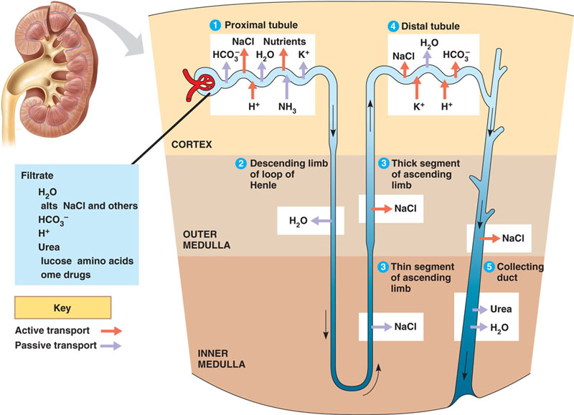
Tubular Reabsorption (continued)
https://www.kvhs.nbed.nb.ca

Slide 66
Tubular Reabsorption (continued)
Ions reabsorbed in the proximal convoluted tubules include:
Na⁺ (sodium)
K⁺ (potassium)
Ca²⁺ (calcium)
Cl- (chloride)
HCO₃⁻ (bicarbonate)
HPO₄²⁻ (phosphate)
The distal convoluted tubules make fine adjustments to ion and water balances.
Page 996
Page 1081
Page 1034

Slide 67
Tubular Reabsorption Routes
A substance reabsorbed from the renal tubules enters a peritubular capillary by one of two paths:
Paracellular reabsorption
Transcellular reabsorption
Peritubular capillaries = very small blood vessels located alongside the tubules of nephrons that enable reabsorption and secretion between the blood and the inner lumen of the nephron.
Page 996
Page 1082
Page 1035
Figure 26.11

Slide 68
Peritubular Capillaries
Kidney
Nephron (enlarged)
Peritubular capillaries
(enlarged)
Renal corpuscle
(further enlarged)
https://www.pitt.edu

Slide 69
Tubular Reabsorption Routes (continued)
In paracellular reabsorption, fluid and solutes exit the renal tubule and enter the peritubular capillaries through gaps between the cells of the tubule.
In transcellular reabsorption, a solute passes from the tubule, and through the tubule cell with the assistance of transport proteins.
Paracellular reabsorption is a passive process, while transcellular reabsorption is an active process—that is, it requires energy from ATP or other high energy molecules.
Page 996
Page 1082
Page 1035
Figure 26.11

Slide 70
Obligatory Water Reabsorption
The reabsorption of water from the renal tubules is mostly via osmosis.
About 90 percent of the reabsorption of filtered water occurs along with the reabsorption of solutes including Na⁺, Cl⁻, and glucose (C₆H₁₂O₆).
Water reabsorbed in this manner in called obligatory water reabsorption because the water is “obligated” through osmosis to follow solutes when they are reabsorbed.
Obligatory water reabsorption occurs in the proximal convoluted tubule and the loop of Henle since these segments are especially permeable to H₂O molecules.
Page 998
Page 1083
Page 1036

Slide 71
Facultative Water Reabsorption
The reabsorption of the remaining ten percent of the water, about ten to 20 liters per day, is through facultative water reabsorption.
This process is regulated by antidiuretic hormone (ADH) secreted by the posterior pituitary as covered in the lecture module on hormones.
Facultative reabsorption occurs in the distal convoluted tubules and collecting ducts.
Page 998
Page 1083
Page 1036

Slide 72
Tubular Secretion
A second major function of nephrons and collecting ducts is tubular secretion.
Tubular secretion involves the transfer of substances from the blood and tubule cells into the fluid of the renal tubules.
Secreted substances include H⁺, NH₄⁺ (ammonium ions), creatinine, and some drugs including penicillin.
The secretion of H⁺ ions helps to control the pH of the blood to main-tain proper acid-base balance.
Page 996
Page 1083
Page 1035

Slide 73
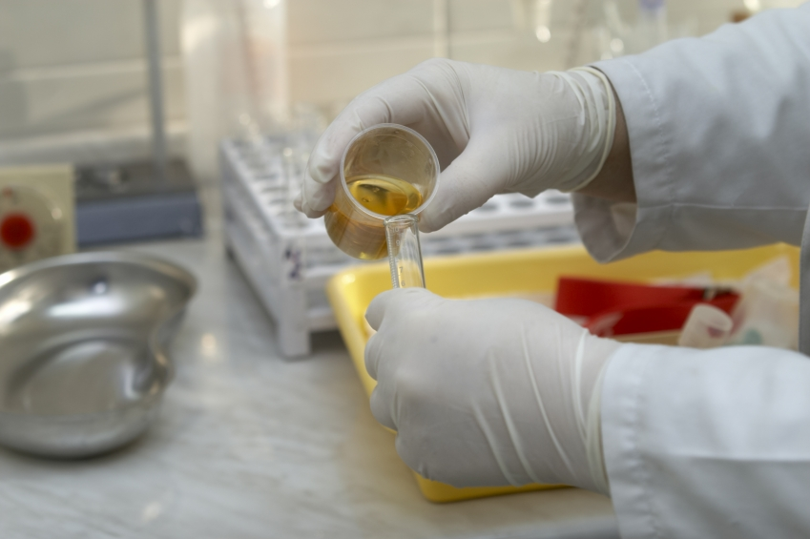
Urinalysis—Drug Testing
https://www.lowesforpros.com

Slide 74
Urinalysis—Drug Testing (continued)
Substances that pass into the urine via tubular secretion can be detected by analysis of the chemical composition of urine sam-ples.
Urinalysis can detect the presence of performance-enhancing substances including:
Anabolic steroids
Erythropoiten (EPO)
Plasma expanders
Human growth hormone (hGH)
Urinalysis can be used to detect the presence of amphetamines, barbiturates, benzodiazepines, cocaine, marijuana, opiates, and PCP (among other substances).
Page 996
Page 1083
Page 1035

Slide 75
Secretion and Reabsorption Details
The textbook contains much more detail on reabsorption and secretion in the:
Proximal convoluted tubule
Loop of Henle
Early distal convoluted tubule
Late distal convoluted tubule
Collecting ducts
Page 996
Page 1083
Page 1036

Slide 76
Hormonal Control
Hormones control:
Na⁺, CL⁻, Ca²⁺, and water reabsorption from the renal tubules
K⁺ secretion from the renal tubules
The hormones include:
Angiotensin II
Aldosterone
Antidiuretic hormone
Atrial natriuretic peptide
Parathyroid hormone
Page 1001
Page 1087
Page 1040

Slide 77
Renin-Angiotensin-Aldosterone System
The walls of the afferent arterioles in nephrons stretch less when blood volume and blood pressure decrease.
This leads to the release of a local hormone known as renin from the juxtaglomerular cells of the nephron.
Sympathetic activity also stimulates the release of renin.
Juxtaglomerular apparatus and cells = a collective term referring to the cells located near the glomerulus in the kidney.
(https://www.medterms.com)
Page 1002
Page 1087
Page 1040

Slide 78
Renin-Angiotensin-Aldosterone System (continued)
Renin is a hormone and enzyme that clips-off a sequence of 10 amino acids known as angiotensin I from angiotensinogen that is synthesized by hepatocytes in the liver.
A second enzyme, angiotensin converting enzyme (ACE), clips-off two more amino acids from angiotensin I to produce angiotensin II.
Angiotensin II is the active form of the hormone that acts upon the kidneys.
Hepatocyte = the major cell type of the liver. The cells are responsible for the synthesis, degradation, and storage of a wide range of substances. They are the site of synthesis of all the plasma proteins, except for antibodies, and are the site of storage of glycogen.
(https://www.answers.com/library)
Page 1002
Page 1087
Page 1040

Slide 79
Renin-Angiotensin-Aldosterone System (continued)
Angiotensin II:
Decreases glomerular filtration rate by vasoconstriction of the afferent arterioles.
Increases the reabsorption of Na⁺, CL⁻ in the proximal convo-luted tubule.
Stimulates the adrenal cortex to release aldosterone, a hor-mone that stimulates the collecting ducts to reabsorb Na⁺ and Cl⁻ and secrete K⁺.
Obligatory water reabsorption increases to increase blood volume.
Page 1002
Page 1087
Page 1040

Slide 80
Antidiuretic Hormone
Antidiuretic hormone (ADH) is secreted by the posterior pituitary as we discussed in the second lecture module on the endocrine system.
ADH regulates facultative water reabsorption by increasing the permeability of the collecting ducts and distal convoluted tubules.
The kidneys produce as little as 500 ml of concentrated urine per day when ADH secretion is high, such as with severely dehydra-tion or hemorrhaging (losing blood).
The kidneys produce a much larger volume of diluted urine when ADH level is low.
Page 1002
Page 1087
Page 1040

Slide 81
Control of Antidiuretic Hormone
When the osmolarity of blood plasma increases due to water loss (as little as 1 percent), osmoreceptors (a type of sensory receptor) in the hypothalamus detect the change.
More ADH is secreted from the posterior pituitary to act upon the kidneys to conserve water.
Osmolarity = the concentration of particles (especially ions) dissolved in a fluid (in this case, blood plasma).
Page 1002
Page 1087
Page 1041
Figure 26.17

Slide 82
Atrial Natriuretic Peptide
Increased blood volume stimulates release of atrial natriuretic pep-tide (ANP) from cells in the atria of the heart.
ANP inhibits the reabsorption of Na⁺ and thus water (by osmosis) in the proximal convoluted tubule and collecting duct.
ANP increases the secretion of Na⁺ in urine and increases urine out-put.
ANP also inhibits the release of ADH from the posterior pituitary and aldosterone from the adrenal cortex (that are both involved in retain-ing water).
Thus, ANP secretion helps to decrease blood volume and blood pres-sure.
Page 1003
Page 1088
Page 1041

Slide 83
Parathyroid Hormone
A lower-than-normal blood level of Ca²⁺⁺ stimulates the release of parathyroid hormone (PTH) from the parathyroid glands.
PTH stimulates cells in the distal convoluted tubules to reabsorb more Ca²⁺⁺ into the blood.
PTH also inhibits HPO₄²⁻ (phosphate) reabsorption in the proximal convoluted tubules, thereby increasing the excretion of phosphate in the urine.
Page 1003
Page 1088
Page 1041

Slide 84
Urine Production

Slide 85
Body Fluid Volume
The total volume of fluid in the body remains fairly constant although a person’s fluid intake can vary considerably.
Fluid volume depends primarily on the kidneys to regulate water loss through urine production.
Normally-functioning kidneys produce a large volume of dilute urine when fluid intake is high.
They produce a small volume of concentrated urine when fluid intake is low or its loss is high—in the latter case, such as in profuse sweat-ing or hemorrhage (blood loss).
Page 1003
Page 1088
Page 1042

Slide 86
Concentrated Urine
When water intake is low or water loss is high, the kidneys conserve water while eliminating wastes and excess ions.
The kidneys produce a small volume of highly-concentrated urine under the influence of ADH.
This urine can be up to four times more concentrated than either the blood plasma or glomerular filtrate.
The textbook provides a substantial amount of detail on urine produc-tion.
Page 1004
Page 1088
Page 1043
Figure 26.17

Slide 87
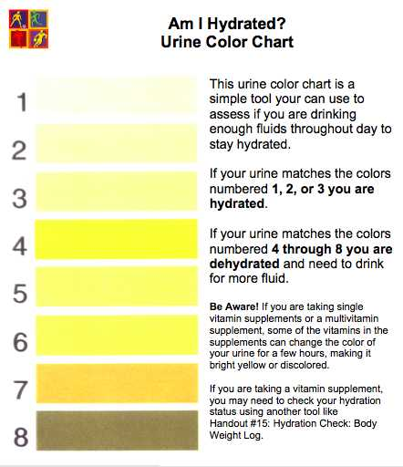
Urine Color Chart
https://www.nuclearfamily.files

Slide 88
Evaluation of Kidney Function

Slide 89
Urinalysis
Urinalysis, in addition to its use in drug testing, can provide other information about the body.
The characteristics of urine include its volume, color, turbidity, odor, pH, and specific gravity.
A number of factors can affect urine volume including fluid intake, blood pressure, osmolarity, diet, body temperature, use of diuretics, and general health.
Turbidity = thick or opaque with matter in suspension.
Specific gravity = the density of a substance relative to the density of water.
Diuretic = any substance that tends to increase the flow of urine.
Page 1008
Page 1092
Page 1047
Table 26.5

Slide 90
Urinalysis (continued)
Water normally accounts for about 95 percent of the total volume of urine.
The remaining five percent consists of electrolytes, molecules from cellular metabolism, and exogenous substances including various drugs.
Electrolyte = a substance that dissociates into ions in solution and acquires the capacity to conduct electricity. Examples of electrolytes are sodium, potassium, chloride, calcium, and phosphate ions.
(https://www.medicinenet.com)
Exogenous = produced or originating outside of an organism (human).
Page 1008
Page 1094
Page 1047

Slide 91
Urinalysis (continued)
Solutes found in urine generally include:
Filtered and secreted electrolytes
Urea from the chemical breakdown (catabolism) of proteins
Creatinine from the breakdown of creatine phosphate in muscle fibers
Uric acid from the breakdown of nucleic acids
Urobilinogen from the breakdown of hemoglobin
Small amounts of fatty acids, pigments, enzymes, and hormones
Page 1008
Page 1094
Page 1047

Slide 92
Urinalysis (continued)
Traces of substances not normally present in the urine can appear when the body’s metabolism or kidneys are affected by disease.
Normally occurring substances might be found in abnormally high amounts.
Substances that may indicate illness are described in Table 26.6 of the textbook.
They include albumin, glucose, red blood cells, ketone bodies, bili-rubin, and microbes.
Bilirubin = product of the breakdown of the heme portion of hemoglobin molecules in red blood cells.
Page 1008
Page 1094
Page 1047
Table 26.6

Slide 93
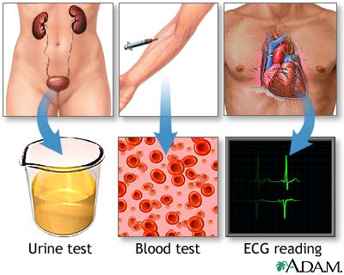
Urinalysis and Other Tests
“Routine lab tests are recommended before beginning treatment of high blood pressure to determine organ or tissue damage or other risk factors. These lab tests include urinalysis, blood cell count, blood chemistry (potassium, sodium, creatinine, fasting glucose, total cholesterol and HDL cholesterol), and an ECG (electrocardiogram). Additional tests may be recommended based on your condition.”
(https://www.nlm.nih.gov)

Slide 94
Blood Urea Nitrogen Test
The blood urea nitrogen (BUN) test measures the nitrogen level in urea, which is from the catabolism and deamination of proteins in body tissues.
BUN will rise steeply when the glomerular filtration rate decreases severely, such as in renal disease or obstruction of the urinary tract.
One treatment strategy is minimizing protein intake in a patient’s diet to reduce the rate of urea production.
Catabolism = breakdown of proteins for energy and raw materials (amino acids).
Deamination = removal of the amino radical from an amino acid or other amino compound.
Page 1008
Page 1094
Page 1047

Slide 95
Plasma Creatinine Measurement
Creatinine is a byproduct of the breakdown of creatine phosphate in skeletal muscle.
The blood plasma level is normally low because its rate of excretion in the urine equals its discharge from skeletal muscle.
A high creatinine level can indicate poor renal function since it is not being excreted in adequate amounts.
Page 1008
Page 1094
Page 1047

Slide 96
Renal Plasma Clearance
Renal plasma clearance is the volume of blood that is cleared of a substance per unit of time.
The measure is expressed in milliliters per minute (mL / min).
A high renal plasma clearance indicates an efficient excretion of a substance in the urine, while low clearance indicates inefficient ex-cretion.
Inefficient excretion can indicate kidney disease.
Page 1008
Page 1094
Page 1047

Slide 97
Renal Plasma Clearance (continued)
Knowledge of renal clearance rate of a drug is essential in determin-ing the correct dosage.
If a person’s renal clearance rate is high, such as for penicillin, larger or more frequent amounts of the antibiotic must be given.
This to maintain an adequate blood plasma level of the antibiotic to combat a bacterial infection.
Page 1008
Page 1094
Page 1047

Slide 98
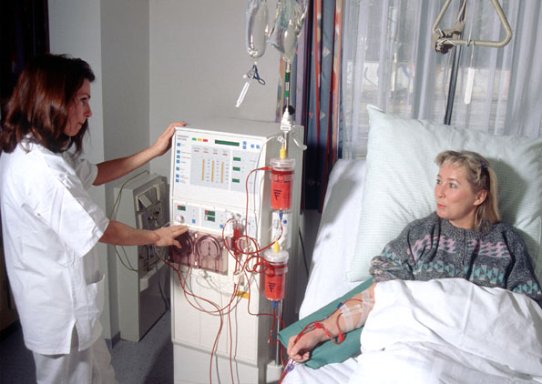
Hemodialysis
https://www.nocturnaldialysis.org

Slide 99
Hemodialysis (continued)
Blood must be artificially cleansed if the kidneys cannot function adequately due to disease or injury.
Hemodialysis separates large solutes from smaller ones in blood plasma using a selectively-permeable membrane.
The procedure is used for filtering the blood to remove wastes and excess electrolytes and fluid and returning the blood to the patient.
The textbook has a short description of the technology and proce-dures.
Page 1010
Page 1095
Page 1048

Slide 100
Urine Transportation, Storage, and Elimination

Slide 101
Urine Pathway
From the collecting ducts in the kidneys, urine then:
Drains through the papillary ducts into the minor calyces of the kidneys,
Which join to become the major calyces that converge to form the renal pelvis,
From which it drains into the ureters, and then into the urinary bladder, and
From where it is discharged from the body through the urethra.
Page 1010
Page 1096
Page 1049
Figure 26.1
Figure 26.3

Slide 102
Ureters
Each ureter transports urine from the renal pelvis of a kidney to the urinary bladder.
Peristaltic contractions in the smooth muscle walls of the ureters propel urine toward the bladder.
Hydrostatic pressure and gravity also contribute to the movement of urine into the bladder.
Peristalsis = successive waves of involuntary contraction passing along the walls of a hollow smooth muscle structure.
(https://www.merriam-webster.com)
Page 1010
Page 1096
Page 1049
Figure 26.21

Slide 103
Ureters (continued)
An anatomical valve is not found at the opening of each ureter to the urinary bladder.
As the bladder fills with urine, the increased internal pressure within the bladder compresses the openings and prevents the backflow of urine into the ureters.
Microbes, including bacteria, could otherwise travel via the ureters to infect the kidneys.
Page 1010
Page 1097
Page 1049
Figure 26.21

Slide 104
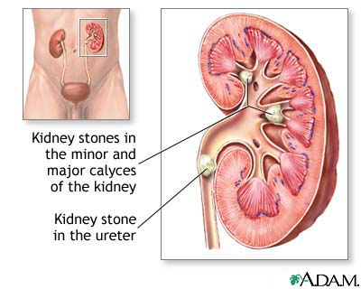
Kidney Stones
“Kidney stones result when urine becomes too concentrated and substances in the urine crystallize to form stones. Symptoms arise when the stones begin to move down the ureter causing intense pain. Kidney stones may form in the pelvis or calyces of the kidney or in the ureter.”
(https://www.drrajmd.com)

Slide 105
Urinary Bladder
The urinary bladder is a hollow, distensible organ with smooth mus-cle tissue in its wall.
The capacity of the urinary bladder is about 700 to 800 mL.
The bladder forms a spherical shape when urine accumulates and collapses when emptied.
As the volume of urine continues to increase, the bladder becomes pear-shaped and rises from the pelvic cavity and into the abdominal cavity, producing the sensation of a full bladder.
Distensible = capable of being stretched and expanded.
Page 1011
Page 1097
Page 1050
Figure 26.21

Slide 106
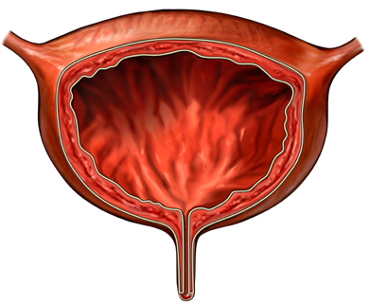
Urinary Bladder and Incontinence
“Urinary incontinence is the loss of voluntary bladder control causing leakage of urine. The temporary or chronic condition has multiple mechanisms and many causes. It can occur when you are straining (lifting, sneezing, coughing), when your bladder is full, or when you have a bladder infection. Each cause has its own methods of diagnosis and its own treatment plan.”
(https://www.beliefnet.com)

Slide 107
Micturition Reflex
The discharge of urine from the urinary bladder is called micturition, urination, or voiding.
Micturition involves involuntary and voluntary muscle contractions.
Bladder pressure increases when urine volume exceeds 200 to 400 mL.
Stretch receptors in the bladder wall transmit nerve impulses to the micturition center (a collection of nuclei) in the S1 and S2 segments of the spinal cord.
Page 1012
Page 1097
Page 1050

Slide 108
Micturition Reflex (continued)
In the micturition reflex arc, parasympathetic impulses propagate via motor fibers (axons) to the urinary bladder wall and internal urethral sphincter.
Urination occurs with the contraction of the urinary bladder wall and relaxation of the internal sphincter of smooth muscle fibers.
While emptying of the urinary bladder is a reflex, children can learn to initiate it and stop it voluntarily using the external sphincter of skeletal muscle fibers.
Punishing a child is not an effective means for stopping bedwetting (there can be physiological and psychological factors that need to be addressed).
Propagate = travel
Page 1012
Page 1097
Page 1050

Slide 109
Urethra
The urethra leads from the internal urethral orifice in the floor of the bladder to the exterior.
In females and males, the urethra is the passageway for discharg-ing urine from the body.
In males, the urethra also discharges semen and small amounts of pre-ejaculatory fluids.
Page 1013
Page 1099
Page 1050
Figure 26.22

Slide 110
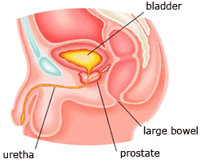
Prostate
https://www.prostatecancer-riskcalculator.com

Slide 111
Prostatic Changes
The prostate enlarges up to two to four times its original size in many men over 60 years old.
The condition, known as benign prostatic hyperplasia (BPH), compres-ses the prostatic urethra and reduces its diameter.
Signs of BPH can include:
Hesitancy in urination
Decreased force of the urinary stream
Incomplete voiding of the bladder
More frequent urination
Dribbling after urination
Bedwetting (nocturia)
Page 1080
Page 1171
Page 1122
111
Notes:
111

Slide 112
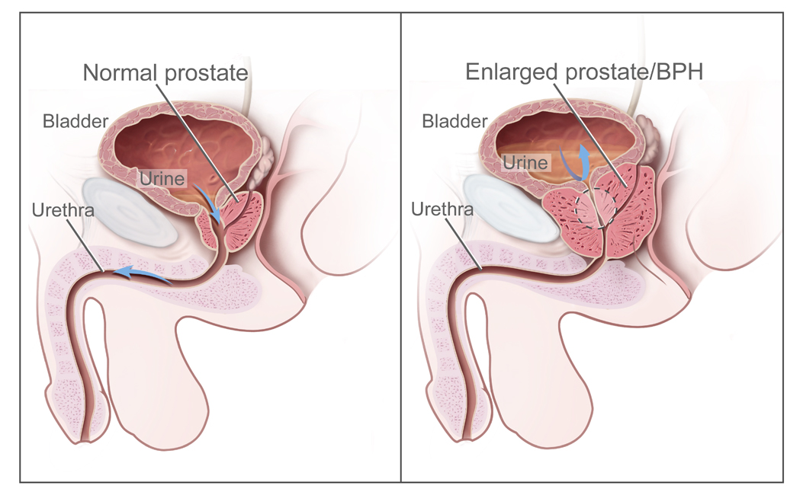
Benign Prostatic Hyperplasia
https://www.health-res.com
112
Notes:
112

Slide 113
Prostate Exams
Men should have periodic prostate exams as they get older so that prostate cancer can be detected at an early stage and distinguished from benign prostatic hyperplasia (BPH).
Prostate cancer can be detected using the prostate specific antigen (PSA) test, although the method is neither highly specific nor highly-sensitive (another words, the test is error prone).
Thus, the PSA test can yield false positive and false negative results.
“Sensitivity is a measure of how well a test can identify true positives and specificity is a measure of how well a test can identify true negatives. For diagnostic testing and screening, there is usually a trade-off between sensitivity and specificity, such that higher sensitivities will mean lower specificities and vice versa.”
(https://www.wikipedia.org)
Page 1080
Page 1171
Page 1122
113
Notes:
113

Slide 114
Prostate Exams (continued)
A definitive diagnosis can be established with tissue biopsy of the prostate.
Prostate cancer can be best treated if it is detected at an early stage.
Page 1080
Page 1171
Page 1122
114
Notes:
114

Slide 115
Waste Management in Other Body Systems

Slide 116
Waste Management
A major function of the renal and urinary system is to eliminate waste materials from the body.
Other systems are also involved in waste management, as described on the next slides.
Page 1014
Page 1100
Page 1052

Slide 117
Other Systems
Buffers in body fluids bind excess H⁺ ions to prevent an increase in acidity.
Blood transports metabolic waste products.
The liver is the primary site for recycling and the conversion of amino acids into glucose and glucose into fatty acids.
The liver also converts toxic substances into less toxic ones, such as ammonia from protein catabolism into urea for elimination from the body.
Page 1014
Page 1100
Page 1053

Slide 118
Other Systems (continued)
The lungs expel CO₂, and some heat and water vapor upon exhala-tion.
Sudoriferous (sweat) glands in the skin help eliminate excess heat, water, and some CO₂.
Sudoriferous glands also excrete small quantities of salts and urea.
The digestive tract, through defecation, excretes undigested foods, wastes, some CO₂, some water, salts, and heat.
Page 1014
Page 1100
Page 1053

Slide 119
Aging

Slide 120
Aging Effects
With aging, the kidneys shrink in size, have less blood flow, and filter less blood.
Kidney mass decreases from an average of about 300 grams in 20-year-olds to 200 grams in 80-year-olds.
Reduced blood flow may be due to damaged or decreased numbers of glomeruli and other blood vessels.
Glomerular filtration rate decreases by about 50 percent between the ages of 40 and 70.
By age 80, about 40 percent of the glomeruli no longer function, which reduces filtration, reabsorption, and secretion.
Page 1016
Page 1103
Page 1053

Slide 121
Aging Effects (continued)
Acute and chronic kidney inflammations and kidney stones are more common with aging.
Older individuals can be susceptible to dehydration because the sen-sation of thirst diminishes with aging.
Acute = of abrupt or sudden onset.
Chronic = persisting for a long time.
Page 1016
Page 1103
Page 1053

Slide 122
Aging Effects (continued)
The urinary bladder decreases in size and capacity with aging, and its smooth muscles weaken.
Urinary tract infections and other urinary problems are more com-mon in older people including:
Polyuria—excessive urine production
Nocturia—excessive urination at night
Increased frequency of urination at all times
Dysuria—painful urination
Urinary retention or urinary incontinence
Hematuria—blood in the urine
Page 1016
Page 1103
Page 1053

